Slide 1
Performance Tuning

Slide 2
Query Optimization
SQL Query optimization is a process of writing thoughtful SQL queries to improve database performance.
During development, the amount of data accessed and tested is less. Hence, developers get a quick response to the queries they write.
But the problem starts when the project goes live, and enormous data starts flooding the database. Such instances slow down SQL queries response drastically and create performance issues.
When working with large-scale data, even the most minor change can have a dramatic impact on performance.
Benefits of Query Optimization
Process more queries in the same amount of time
Provide users with faster results
control product states

Slide 3
SQL Query Optimization Tips
Indexing: Ensure proper indexing for quick access to the database.
Select query: Specify the columns in SELECT query instead of SELECT* to avoid extra fetching load on the database.
Running queries: Loops in query structure slows the sequence. Thus, avoid them.
Matching records: Use EXITS() for matching if the record exists.
Subqueries: Avoid correlated sub queries as it searches row by row, impacting the speed of SQL query processing.
Wildcards: Use wildcards (e.g. %xx%) wisely as they search the entire database for matching results.
Operators: Avoid using function at RHS of the operator.
Fetching data: Always fetch limited data.
Loading: Use a temporary table to handle bulk data.
Selecting Rows: Use the clause WHERE instead of HAVING for primary filters.
Notes:
https://www.mantralabsglobal.com/blog/sql-query-optimization-tips/

Slide 4
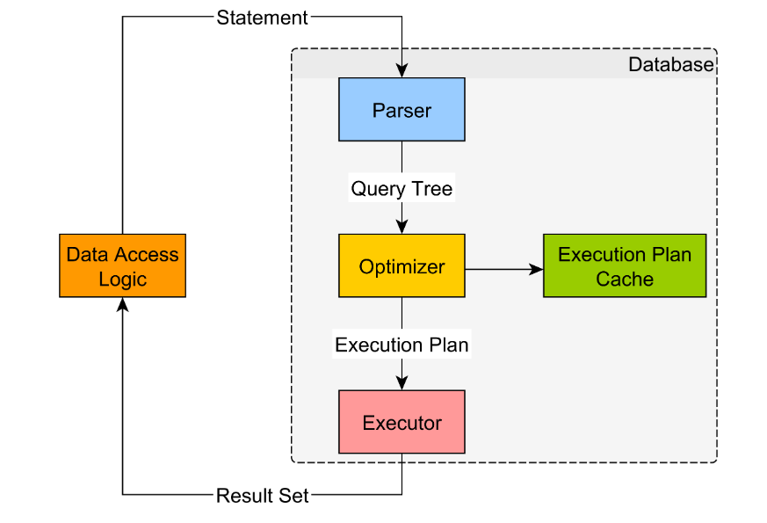
SQL Execution Plan
The first step is to parse the SQL query into an AST (Abstract Syntax Tree).
The resulting Query Tree is sent to the Optimizer, which produces a step-by-step list of operations that are needed in order to fetch the desired result set.
The resulting execution plan is sent to the Executor, which runs it and sents the fetched result set back to the database client.

Slide 5
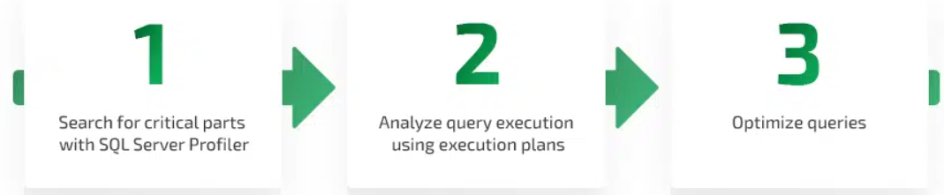
Steps to improve Query Performance
SQL Server Profile : It helps you trace queries received by the server
Execution Plan : Created by the SQL Server Query Optimizer, an execution plan provides you with information on how a query will be executed, showing you all actions that constitute this query.
Optimize queries : Use Optimization Techniques to improve the Query performance

Slide 6
Execution Plan
SSMS can display three types of execution plans
Estimated execution plan : A compiled plan produced by the query optimizer based on query execution estimates.
Actual execution plan — A compiled plan with its execution context that includes actual runtime information like execution warnings. It becomes available once query execution is completed.
Live query statistics — A compiled plan with its execution context that includes runtime information such as the actual number of rows flowing through the operators, elapsed time, and estimated query progress
SET SHOWPLAN_ALL ON | OFF
SET STATISTICS IO, TIME, PROFILE ON
Notes:
https://www.apriorit.com/dev-blog/381-sql-query-optimization

Slide 7
Q
A
Thank you

